Slide 1
Software Requirements Specification
Ben Houser, Anthony Dohogne, Marshall Rosenhoover, Tyler Ball

Slide 2
Sources
Statement of Work
We got the majority of the requirements from here
Discussions with Customer
Emailed the customer and brought up potential ideas and issues for further requirements
Programmer Decisions
We made a few independent decisions on what ought to be required (primarily concerning architecture and design)

Slide 3
Functional Requirements
Some key requirements:
F1: Software must allow for league management and maintain player information and statistics. (SOW)
F3: Software must enforce dart rules: scoring for leg start at 801, 501, or 301, and the winner must hit 0 by hitting a double. (SOW)
F5: The software must display winning throws if a player is able to win in one turn. The suggested last throw should be the largest double possible. (SOW)

Slide 4
Functional Requirements(cont.)
F7: The scorekeeping interface must consist of a dartboard GUI used to mark the throw, and will take bounce-outs, knock-outs, and fouls into account. (SOW)
F14: The software must facilitate scoring in real-time with the match. Dart scoring should be as efficient as possible, so as not to slow down the match. (SOW)

Slide 5
Product Level Requirements
P1: The software must have web connectivity to be accessed via web pages (Discussions with Customer)
P3: The software must update close to real-time, so calculations must be efficient and server communication should be as fast as possible (Discussions with Customer)
P5: The software must perform reliably and consistently, so identical matches should have identical results. (SOW)

Slide 6
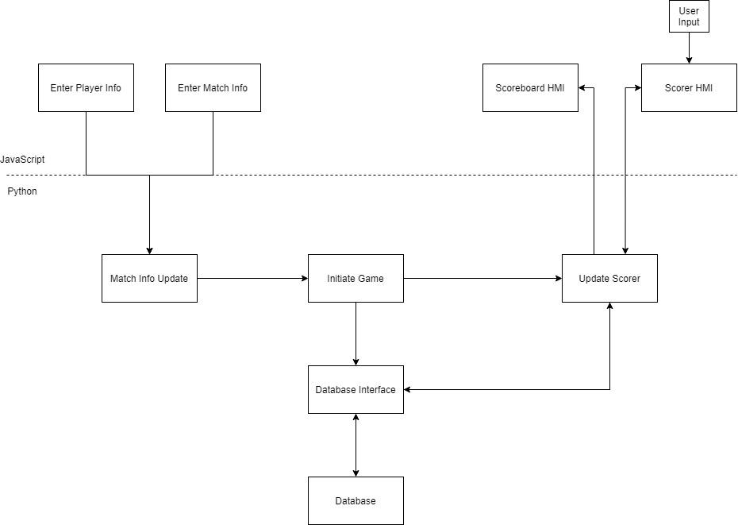
System States

Slide 7
Backlog
F4: The software must display an indicator if a player is on track for a perfect leg (minimum number of throws). (SOW)
User stories: Minimum Throws, Calculate Min Throws, Calculate Winning Throws
F6: The software must consist of two GUIs; one is the scoreboard and the other is the scorekeeping tool (SOW, Discussions with Customer)
User stories: Match Info Menu, Display Stats, Game Type Menu, Display Scores, Display Perfect Leg, Display Winning Throws, Leg Count Menu

Slide 8
Backlog(cont.)
F7: The scorekeeping interface must consist of a dartboard GUI used to mark the throw, and will take bounce-outs, knock-outs, and fouls into account. (SOW)
User Stories: Scoring, Display Scores, Information Review
P3: The software must update close to real-time, so calculations must be efficient and server communication should be as fast as possible (Discussions with Customer)
User Stories: Calculate Minimum Throws, Display Stats, Display Scores, Display Winning Throws

Slide 9
FIN

